Slide 1
ITSM – Session 10
Phalachandra HL
Acknowledgements:
Significant portions of the information in the slide sets presented through the course in the class are extracted from IT Systems Management -Rich Schiesser and other books/Internet. Since these were intended for presentation in the class room for teaching, instructor resources has been requested from the publisher, but not received yet. I would like to sincerely thank, acknowledge and reiterate that the credit/rights remain with the original authors/publishers only

Slide 2
IT Systems Management
Recap
IT Infrastructure Systems Management involves managing the IT Services running on the IT infrastructure environment components like the Servers, Disk Storage, DBs, Networks and Desktop environments, and providing a stable and responsive IT environment, which supports or furthers the Business of the organization, while being Available, Responsive, Cost efficient, Secure, Scalable,…
We discussed on the support needed from executives, organization structure and positioning of the groups which provide these management services, given that one of the KSF are people, we discussed on approaches for staffing and retaining people with required skills and skill levels, the personal and business ethics or lack of it and it’s impact in-terms of legislation and what that drives into organizations
We also looked at how to evolve the services to a customer centric approach and leveraging the best practices using frameworks like ITIL
Then as part of the 12 Key processes which have been discussing in the course from Availability, Performance-Tuning, Production Acceptance process, Change Management, Problem Management, Storage Management, Network Management, Configuration Management, Capacity Management, Strategic Security and Business continuity

Slide 3
IT Systems Management
Recap - 1
As part of Strategic Security Management, we looked at the overall process for developing a strategic security program, beginning with our formal definition of strategic security and then discussed the 12 steps necessary to design such a process including looking at the current tools and processes and streamlining them, establishment and enforcement of enterprise-wide security policies etc. We concluded the session with how to evaluate, measure, and streamline a strategic security process
IT infrastructure disasters and disruptions can happen in at least 20% of organizations every year. As part of Business Continuity process, we looked at how to plan for the continuity of critical business processes during and immediately after disruptions of service resulting from either a localized or a wide-spread disaster. We looked at the steps required to design and test a business continuity plan right from acquiring Executive support, process owner, building of a cross functional team, conducting a Business Impact analysis, identifying and prioritizing requirements, identification of recovery team and strategies, planning of a Business continuity plan, validating it and keeping it current.

Slide 4
Facilities Management Process

Slide 5
ITSM : Facilities Management
Context
What would you see as activities involved with facilities Management
Do you see Facilities Management as Strategic or Tactical
Do you think facilities management is changing from the past one year
Notes:
Facilities management from a workplace - End User experience - is focused towards creativity, collaboration and mobility – happy and fulfilment in the workplace – enhancing service levels – Delightful human experience – Drive innovation, Differentiate and standout, Inject culture, Boost well being, Increase agility
Cost/m2 – Sustainability, SLA indicators .. Sustainability .. Employee satisfaction -> productivity .. Activity based workplaces .. Technology enabling workplaces … New ways of delivering services .. Virtual reality .. Decorations .. Meeting rooms .. Aesthetics ..
Weakness : Tangible definition .. Easy to understand ..

Slide 6
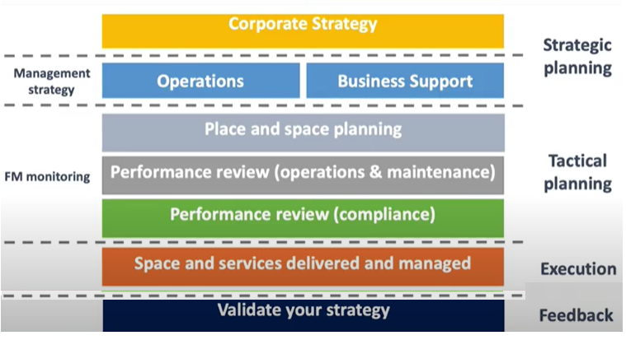
ITSM : Facilities Management
Context
Customers
Notes:
Facilities management from a workplace - End User experience - is focused towards creativity, collaboration and mobility – happy and fulfilment in the workplace – enhancing service levels – Delightful human experience – Drive innovation, Differentiate and standout, Inject culture, Boost well being, Increase agility
Cost/m2 – Sustainability, SLA indicators .. Sustainability .. Employee satisfaction -> productivity .. Activity based workplaces .. Technology enabling workplaces … New ways of delivering services .. Virtual reality .. Decorations .. Meeting rooms .. Aesthetics ..
Weakness : Tangible definition .. Easy to understand ..

Slide 7
ITSM : Facilities Management
Introduction
Facilities management needs to proactively ensure the stability of the physical infrastructure environment to ensure the continuous operation of critical equipment to process critical applications.
This leads to the need for considering the major elements associated with managing the physical environment of an IT infrastructure.
Typically most organizations have a facilities department which takes care of the physical infrastructure, and thus this Facilities management process will need to ensure that the role complements the organizational role and clear responsibilities are established for both
Def: Facilities management is a process to ensure that an appropriate physical environment is consistently provided to the IT Infrastructure team to enable the continuous operation of all critical infrastructure equipment
An appropriate physical environment implies that all environmental factors (such as air conditioning, humidity, electrical power, static electricity, and controlled physical access) are accounted for at the proper levels on a continuous basis.
All critical infrastructure equipment refers to hardware in the data center, including the key infrastructure devices located outside of the centralized facility, including switch rooms, vaults, wiring closets, and encryption enclosures
Notes:
Facilities management from a workplace - End User experience - is focused towards creativity, collaboration and mobility – happy and fulfilment in the workplace – enhancing service levels – Delightful human experience – Drive innovation, Differentiate and standout, Inject culture, Boost well being, Increase agility
Cost/m2 – Sustainability, SLA indicators .. Sustainability .. Employee satisfaction -> productivity .. Activity based workplaces .. Technology enabling workplaces … New ways of delivering services .. Virtual reality .. Decorations .. Meeting rooms .. Aesthetics ..
Weakness : Tangible definition .. Easy to understand ..

Slide 8
ITSM : Facilities Management
Major Elements of Facilities Management
1. Air conditioning (and Chillers & CRAC Units)
All active components which are part of the IT Infrastructure in a Data Center generate heat. This heat generated would increase with the increase in utilization of the components.
Temperature levels will need to be monitored constantly, either electronically or with recording charts, and reviewed once periodically in close intervals to detect any unusual trends.
High density devices such as blade servers can result in hot spots within a data center. These concentrations of heat need to be addressed with proper cooling design and use of Air Conditioners, Chillers, Cold Air flow Dynamics etc. keeping in context the impact of dew
2. Humidity
Humidity or the water vapor contained in air protects IT equipment from dangerous static electrical discharge.
Data centers need to maintain an ambient relative humidity levels between 45% and 55% for optimal performance and reliability. When relative humidity levels are too high, and exceeds the dew point, water condensation can occur which results in hardware corrosion and early system and component failure

Slide 9
ITSM : Facilities Management
Major Elements of Facilities Management (Contd.) - 1
3. Electrical power
Electrical power includes continuous supply at the proper voltage, current, and phasing as well as the conditioning of the power.
Conditioning increases the quality of the electricity for greater reliability by filtering out stray magnetic fields (that can induce unwanted inductance), stray electric fields (that can generate unwanted capacitance), and providing surge suppression to prevent voltage spikes.
Power Distribution Unit (PDUs) designed to distribute power
4. Static electricity
Static electricity, which affects the operation of sensitive equipment, can build up in conductive materials such as carpeting, clothing, draperies, and other non-insulating fibers. Antistatic devices can be installed to minimize this condition.
5. Electrical grounding
Proper grounding is required to eliminate outages and potential human injury due to short circuits.
Notes:
Most of the time positive and negative charges are balanced in an object, which makes that object neutral. Static electricity is the result of an imbalance between negative and positive charges in an object. These charges can build up on the surface of an object (electrons on body) until they find a way to be released or discharged. One way to discharge them is through a circuit.
Total Infrastructure management
Reorganizing Assets and extending their life cycle – 35% reducing – track and manage maintainance and repair – ability to redploy unused assets

Slide 10
ITSM : Facilities Management
Major Elements of Facilities Management (Contd.) - 2
6. Uninterruptible power supply (UPS)
Uninterruptible power supply & the temporary battery backup in the event of commercial power loss for a period of say 15-20 minutes till the power is back or backup generators come on.
The battery of the UPS will need to be fully charged
7. Backup generator
In case of a power failure, which goes beyond the UPS planned capacity, then a backup generators with the capacity to supply for the Critical Business Applications is necessary to ensure the Service Levels are kept high
8. Water detection
9. Smoke detection
Water and smoke detection are common environmental guards in today’s data centers
10. Fire suppression
Fire extinguishers for electrical and non electrical fires have to be factored in and regularly tested

Slide 11
ITSM : Facilities Management
Major Elements of Facilities Management (Contd.) - 3
11. Facility monitoring with alarms
Facility-monitoring systems and their alarms should be visible and audible enough to be seen and heard from almost any area in the computer room, even when noisy equipment such as printers are running at their loudest.
12. Earthquake safeguards
Equipment should be anchored and secured to withstand moderate earthquakes.
13. Safety training
Emergency preparedness for earthquakes and other natural or man-made disasters should be a basic part of general safety training for all personnel working inside a data center.
All personnel trained on emergency procedures, first-aid assistance & have emergency telephone numbers
14. Supplier management
Suppliers to the Data centers should also be informed on the requirements for the equipment being supplied from the Alarms, Safety, and other requirements and ensure that the suppliers are aware and support it

Slide 12
ITSM : Facilities Management
Major Elements of Facilities Management (Contd.) - 4
15. Controlled physical access
Data centre’s should have acceptable methods of controlling physical access to their machine rooms, vaults or rooms that store sensitive documents/tapes etc.
16. Protected vaults
Datacenter protection needs to be beyond external controlled physical access and needs to factor in more multi tier protection, protection to water leaks other internal issues where say critical servers or backups are stored
17. Physical location
18. Classified environments
Locating a data center (including the classified ones) further away from the external walls can help safeguard from outside sabotage, espionage etc.
Datacenters physical location will also need to be carefully chosen to not have obstacles for evacuation

Slide 13
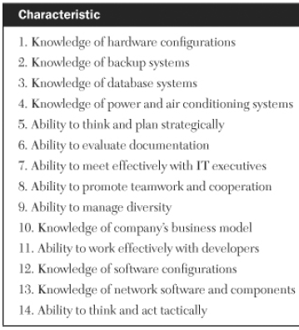

ITSM : Facilities Management
Facilities Management Process Owner :
Responsibilities & Characteristics
There are two factors from a Facilities Management Process Owner perspectives :
Scope of Responsibilities of a Facilities Management Process Owner
This involves differentiating between what are the responsibilities and degree of authority between the Facilities department of an organization and the Facilities Management Process Owner helps in resolving a facilities problem in a datacentre quickly and efficiently versus dragging out the resolution amid chaos, miscommunication, and strained relationships
Desired skills of a Facilities Management Process Owner
Owner of the facilities management process almost always resides in the computer operations department. There are rare exceptions in small Organizations or those with unique outsourcing arrangements where the facilities management process owner is part of the facilities department and matrixed back to IT or is part of the IT executive staff.
The facilities management process owner should have knowledge of H/W configurations and knowledge of basic components of facilities management, such as power and air conditioning, is a high-priority characteristic of an ideal candidate.

Slide 14
ITSM : Facilities Management
Evaluating the Physical Environment
Since Facilities Management Process is intended to ensures the continuous operation of critical equipment, which leads to the need for all of the physical environment of the Datacentre to operate in a sound, stable, and to stay that way.
To determine current state of the physical environment and what is the likely trend of its state in future, information is extracted as part of normal walk-throughs, inspections or routine maintenance and from a number of sources like
Outage logs
Problem tickets
Facilities department staff
Hardware repair technicians
Computer operators
Support staff
Auditors

Slide 15
ITSM : Facilities Management
Major Physical Exposures Common to a Data Center - 1
The list below contains a list of risks which have been known to have been overlooked leading to downtime of the Data centers.
1. Physical wiring diagrams out of date
2. Logical equipment configuration diagrams and schematics out of date
3. Infrequent testing of UPS
4. Failure to recharge UPS batteries
5. Failure to test generator and fuel levels
6. Lack of preventive maintenance on air conditioning equipment
7. Annunciator system not tested
8. Fire‐suppression system not recharged
9. Emergency power‐off system not tested
10. Emergency power‐off system not documented
11. Hot spots due to blade servers
12. Infrequent testing of backup generator system
13. Equipment not properly anchored
14. Evacuation procedures not clearly documented
15. Circumvention of physical security procedures
16. Lack of effective training to appropriate personnel
Notes:
An annunciator panel, is a Centralized Warning Panel or Caution Advisory Panel, is a group of lights used as a central indicator of status of equipment or systems

Slide 16
ITSM : Facilities Management
Actions/Activities which can reduce the Exposures Common to a Data Centre
Designing efficiencies into the physical layout of the computer facility in terms of well-designed floor plan that minimizes time, minimizes motion, and maximizes efficiency for people, air-conditioning, power etc.
Factoring in future expansion due to capacity upgrades, possible mergers, or departmental reorganizations can also assist in keeping current floor plans efficient in the future
Nurture relationships with facilities department
Establish relationships with local government inspecting agencies
Effective monitoring inclusive of Video (periodic checking and validating the recording)
Analysing environmental monitoring reports to identify trends, patterns, and relationships.
Design adequate cooling for hot spots due to concentrated equipment.
Periodic validating of effectiveness of water and fire detection and suppression systems.
Removing all tripping hazards in the computer centre.
Checking on earthquake preparedness of data centre (devices anchored down, training of personnel and tying it into disaster recovery).

Slide 17
ITSM : Facilities Management
Facilities Management at Outsourcing Centres
There are companies where the Infrastructure is outsourced. In these scenarios, although the responsibility for the facilities management process is the concern of outsourcer, client company should take indirect responsibility of ensuring this will happen by asking same types of questions about the outsourcer’s physical environment as they would if the Infrastructure was housed within their premises.

Slide 18
ITSM : Facilities Management
Assessing an Infrastructure’s Facilities Management Process
The worksheet presents a quick-and-simple method for assessing the overall quality, efficiency, and effectiveness of a Facilities Management process

Slide 19
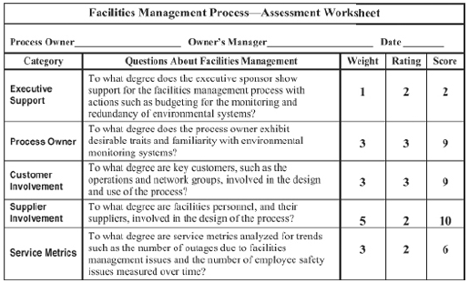
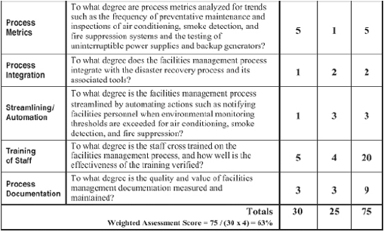
ITSM : Facilities Management
Assessing an Infrastructure’s Facilities Management Process
If we need to tailor this for a specific organization, then with weightages

Slide 20
ITSM : Facilities Management
Measuring and Streamlining the Facilities Management Process
We can measure and streamline the Facilities Management process with the help of the assessment worksheet.
We can measure the effectiveness of a facilities management process with service metrics such as the number of outages due to facilities management issues and the number of employee safety issues measured over time
We can use the Process metrics such as the frequency of preventative maintenance and inspections of air conditioning, smoke detection, and fire suppression systems and the testing of uninterruptible power supplies and backup generators, to help us gauge the efficiency of this process
we can streamline the facilities management process by automating actions such as notifying facilities personnel when environmental monitoring thresholds are exceeded for air conditioning, smoke detection, and fire suppression.

Slide 21
Evaluating Process Documentation

Slide 22
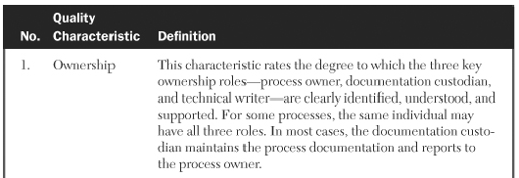
Evaluating Process Documentation
An important aspect of any process is the documentation that accompanies it and good quality documentation adds value to the process and increases the likelihood of the proper use of the process.
Quality of content is to show to what degree the material is suitable for use
Value of the content is to show how important the documentation is to the support of the process and how important the process is to the support of the business.
One technique to objectively quantify and determine the quality and value of process documentation by rating them and plotting them into a magic quadrant.
Documentation Quality Characteristics and Definitions

Slide 23
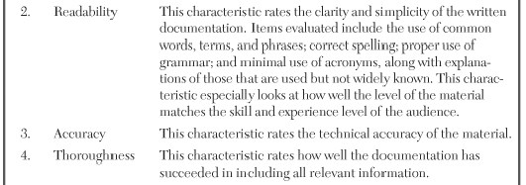
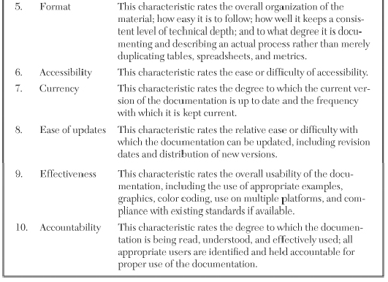
Evaluating Process Documentation : Documentation Quality Characteristics (contd.)

Slide 24
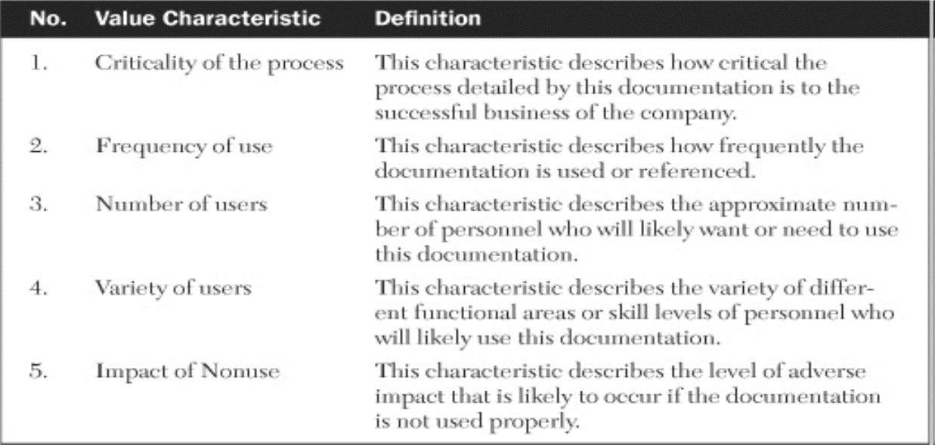
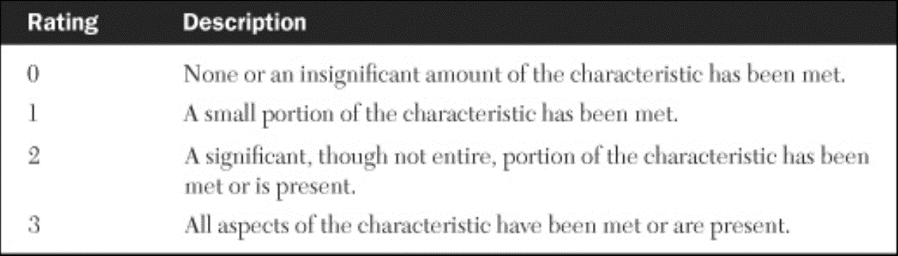
Evaluating Process Documentation
How do we Value Documentation: Characteristics & Definitions
Rating of both of Quality & Value Characteristics of Documentation

Slide 25
Evaluating Process Documentation : Methodology

Slide 26
Benefits of the Methodology to Evaluate Process Documentation
There are three major benefits to this method of documentation evaluation:
It gives a snapshot of the quality of existing documentation. It supplies this at a particular point in time, particularly documentation of high value. If improvements are made to the material which result in new ratings, they can be compared to the current rating.
This method provides the ability to customize the criteria for measuring the quality and value of documentation. This allows for an evaluator to reflect changes in priority, strategy, or direction. In this way, the methodology remains applicable regardless of the specific criteria used.
It allows for comparisons. The third benefit of this method is that it allows for comparisons of documentation between different types of processes within an infrastructure using the same standard of measure.

Slide 27
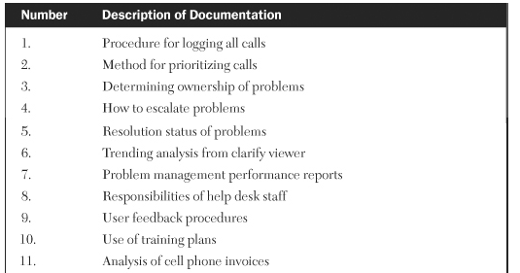
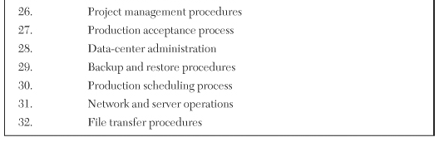
ITSM :
Using Technology to Automate and Evaluate Robust Processes
Evaluating Process Documentation
Documentation Quality Characteristics and Definitions
Types of Infrastructure Documentation Evaluated for Quality and Value as part of an exercise
.
.

Slide 28
Evaluating Process Documentation:
Rating of Quality Characteristics and Definitions
Ratings of Quality Characteristics for Various Types of Infrastructure Process Documentation
Documentation Ownership Readability Accuracy Thoroughness Format Accessibility Currency Updatability Effectiveness Accountability Total

Slide 29
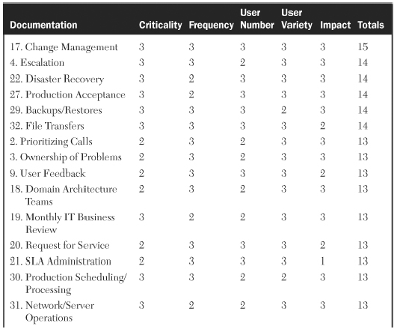
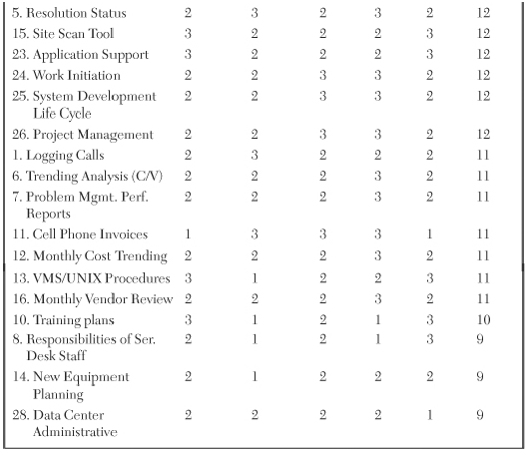
Evaluating Process Documentation: Ratings of Value Characteristics

Slide 30
Evaluating Process Documentation
Documentation Quality Characteristics and Definitions (Contd.)
Putting the Value and Quality ratings together

Slide 31
Quality/Value Matrix
Definition
Example
Needs quick improvement

Slide 32
Discussions
What do you think is the importance of Documentation
How do you evaluate Documentation In your organization?

